Slide 1

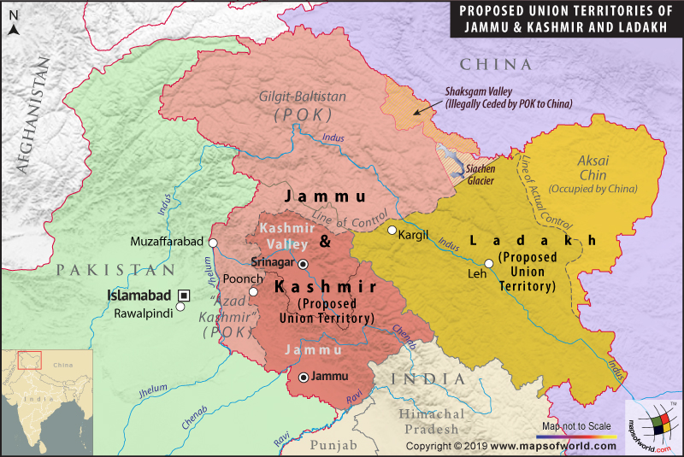
Topics:-
Presidential orders of 1950, 1952 and 1954.
Which provisions of the Indian constitution were made applicable to J&K over time?
Indo-Pak wars of 1965 and 1971 and Simla Agreement.
Why, when and how was Article 370 withdrawn?
What are the legal challenges to the withdrawal of Articles 370 and 35 A?

Slide 2
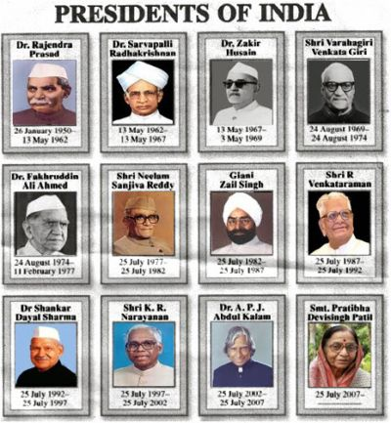
What is Presidential Order ?
The Prime minister in consultation with his cabinet colleagues prepares an order to be signed and issued by the President to make it effective.
At the time of immediate action the President can issue an Ordinance.
An emergency power 'only' given to the executive 'to meet a contingency situation.

Slide 3
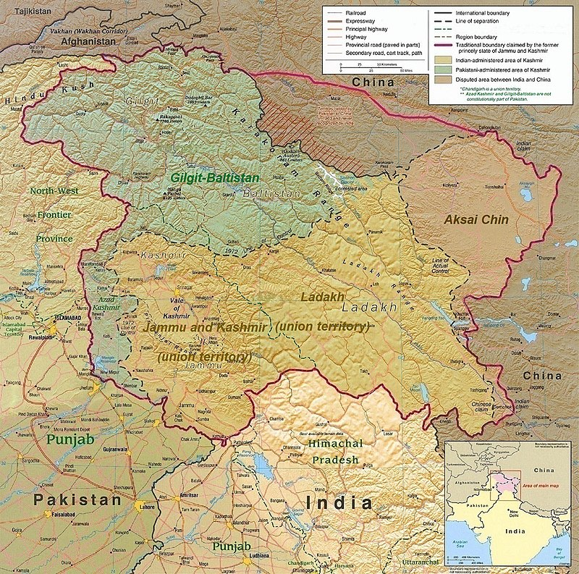
Presidential Order of 1950
The Constitution (Application to Jammu and Kashmir) Order, 1950, came into force on 26 January 1950.
Thirty eight subjects from the Union List were mentioned as matters on which the Union legislature could make laws for the State.
This order was superseded by the Presidential order of 1954.

Slide 4
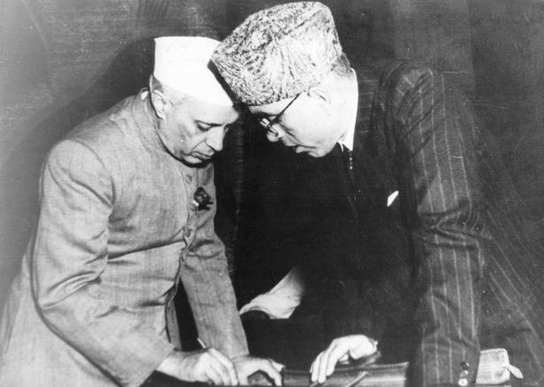
Presidential Order of 1952
The Presidential order of 1952 was published on 15 November 1952.
The Government of India summoned a delegation from Jammu and Kashmir in Delhi for discussions on the relations between the Centre and the State. After discussions, the 1952 DELHI AGREEMENT was reached.
The amendment represented the abolition of the monarchy of Jammu and Kashmir.

Slide 5
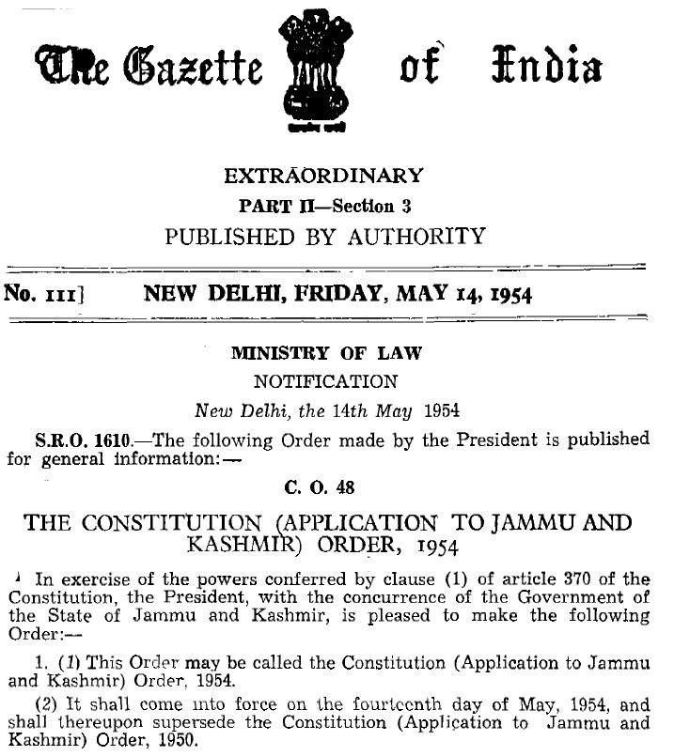
Presidential Order of 1954
The Constitution (Application to Jammu and Kashmir) Order, 1954 came into force on 14 May 1954.
The fundamental rights of the Indian constitution were extended to the state.
The jurisdiction of the Supreme Court of India was extended to the State.
The Central Government was given power to declare national emergency in the event of external aggression.

Slide 6
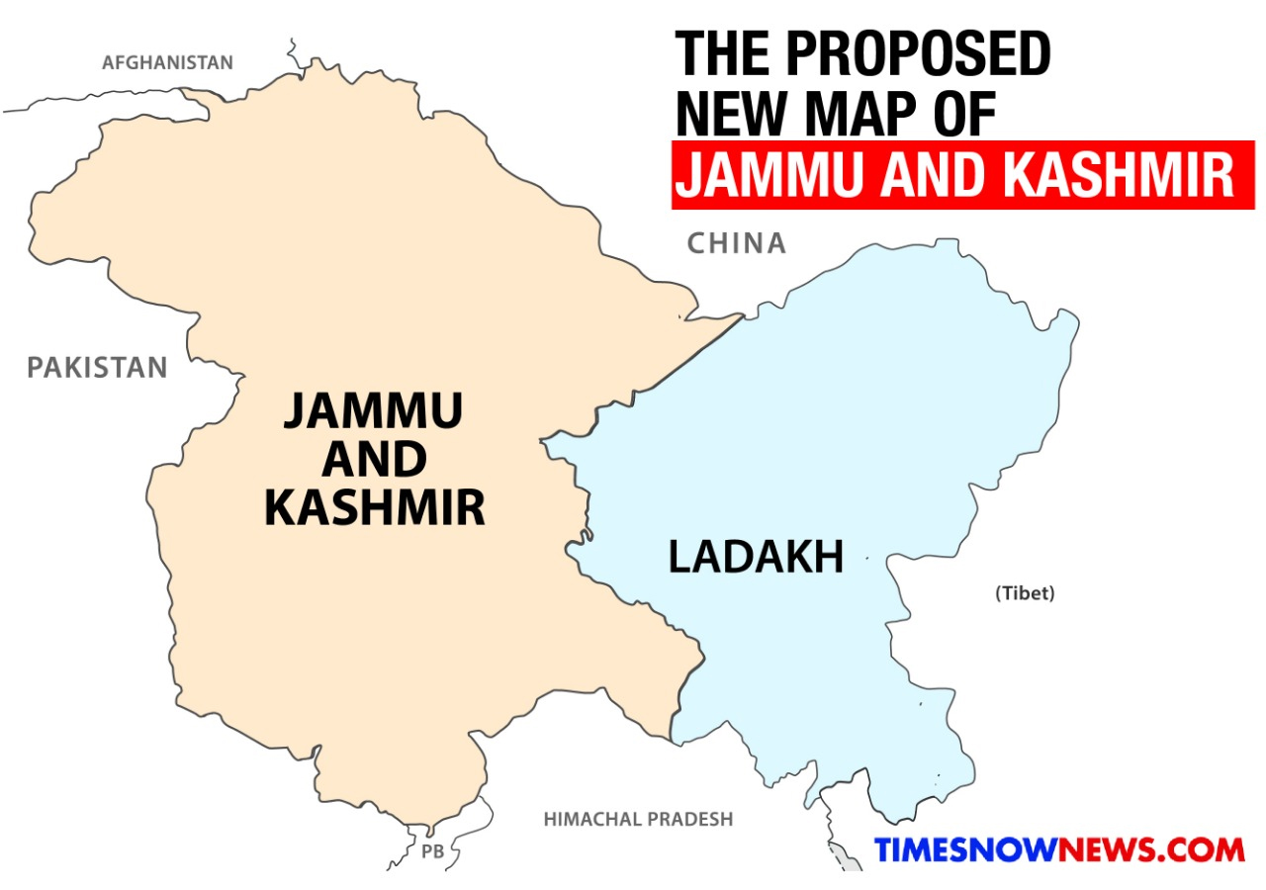
Constitution of J&K
The constitution was adopted on 17 November 1956.
It came into effect on 26 January 1957.
Jammu and Kashmir has a special status among Indian states.
The State of Jammu and Kashmir enjoyed a special but temporary autonomous status as mentioned in Part XXI of the Constitution of India.
Till 1965, the head of state in Jammu and Kashmir was called Sadr-i-Riyasat (Head of State) whereas in other state, the title was Governor, and the head of government was called Prime Minister in place of Chief Minister in other states.

Slide 7
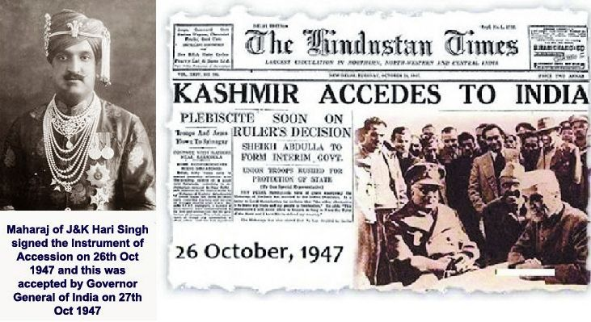
Historical Aspect
J&K chose to remain independent at the time of India, Pakistan Independence.
An agreement was entered by J&K with Pakistan and India that none of them will attack J&K. While India respected the agreement and exercised restraint, Pakistan attacked Kashmir in a bid to annex it by force.
On 6th October 1947, Kashmir was attacked by “Azad Kashmir Forces” supported by Pakistan. To save J&K, the then ruler Maharaja Hari Singh chose to accede J&K to India.
In October 1947, the accession was made by the ruler in favour of India in consideration of certain commitments made by Pt. Jawahar Lal Nehru (the then Prime Minister of India). It was in the pursuance of those commitments that Article 370 was incorporated in the Constitution.
The Ruler of Jammu and Kashmir signed the instrument of accession whereby only three subjects were surrendered by the State to the Dominion of India.
1. External affairs 2. Defense and 3. Communications

Slide 8
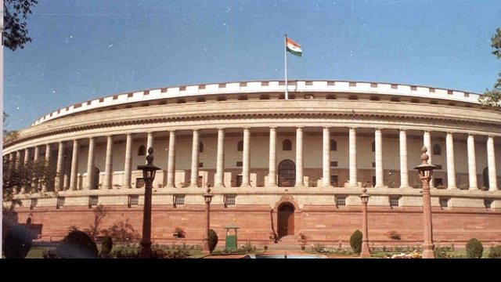
Jurisdiction of Parliament
Limited jurisdiction in case of J&K as compared to other states.
Till 1963, Parliament could legislate on subjects contained in the Union List, and had no jurisdiction in case of Concurrent List under 7th Schedule of the Constitution. But now, the Parliament has power to legislate not just on subjects contained in the Union List but also on some of the subjects of Concurrent List.
Residuary powers, unlike other states, rest with J&K.
The Parliament has no power to legislate Preventive Detention laws for the state; only the state legislature has the power to do so.

Slide 9
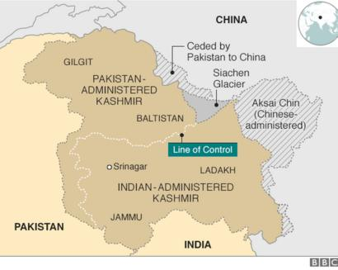
The State enjoys a greater measure of autonomy and the power of the Union of India is restricted, as regards other States.
The Union of India is incompetent to declare financial emergency and emergency in case of failing of constitutional machinery with respect to the State of J&K.
Only emergency due to War or External Aggression can be declared as it is within the scope of “Defense” as surrendered to the Union of India.

Slide 10
Temporary provisions
(1) Notwithstanding anything contained in this Constitution,—
(a) the provisions of article 238 shall not apply now in relation to the state of Jammu and Kashmir
(b) the power of Parliament to make laws for the said state shall be limited to—
(i) those matters in the Union List and the Concurrent List which, in consultation with the Government of the State, are declared by the President to correspond to matters specified in the Instrument of Accession governing the accession of the State to the Dominion of India as the matters with respect to which the Dominion Legislature may make laws for that State; and
(ii) such other matters in the said Lists as, with the concurrence of the Government of the State, the President may by order specify.
(c) the provisions of article 1 and of this article shall apply in relation to that State;
(d) such of the other provisions of this Constitution shall apply in relation to that State subject to such exceptions and modifications as the President may by order specify: Provided that no such order which relates to the matters specified in the Instrument of Accession of the State referred to in paragraph (i) of sub-clause (b) shall be issued except in consultation with the Government of the State:
(2) If the concurrence of the Government of the State referred to in paragraph (ii) of sub-clause (b) of clause (1) or in the second provision to sub-clause (d) of that clause be given before the Constituent Assembly for the purpose of framing the Constitution of the State is convened, it shall be placed before such Assembly for such decision as it may take thereon.
(3) Notwithstanding anything in the foregoing provisions of this article, the President may, by public notification, declare that this article shall cease to be operative or shall be operative only with such exceptions and modifications and from such date as he may specify:
Provided that the recommendation of the Constituent Assembly of the State referred to in clause (2) shall be necessary before the President issues such a notification.

Slide 11
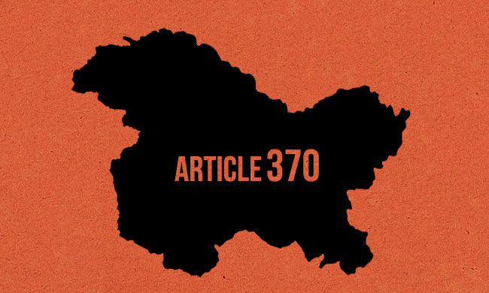
Special Provisions
Article 370 embodied six special provisions for Jammu and Kashmir:
It exempted the State from the complete applicability of the Constitution of India. The State was conferred with the power to have its own Constitution.
Central legislative powers over the State were limited, at the time of framing, to the three subjects of defence, foreign affairs and communications.
Other constitutional powers of the Central Government could be extended to the State only with the concurrence of the State Government.
The 'concurrence' was only provisional. It had to be ratified by the State's Constituent Assembly.
The State Government's authority to give 'concurrence' lasted only until the State Constituent Assembly was convened. Once the State Constituent Assembly finalised the scheme of powers and dispersed, no further extension of powers was possible.
Article 370 could be abrogated or amended only upon the recommendation of the State's Constituent Assembly.

Slide 12
Emergency Provisions
The Union of India has no power to declare Financial Emergency under Article 360 in the state.
The Union can declare emergency in the state only in case of War or External Aggression.
No proclamation of emergency made on the grounds of internal disturbance or imminent danger thereof shall have effect in relation to the state unless
it is made at the request or with the concurrence of the government of the state; or
where it has not been so made, it is applied subsequently by the President to that state at the request or with the concurrence of the government of that state.

Slide 13
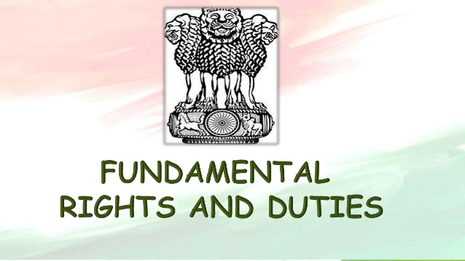
Fundamental duties, directive principles and fundamental rights
Part IV (Directive Principles of the State Policy) and Part IVA (Fundamental Duties) of the Constitution are not applicable to J&K.
Part III- (Fundamental Rights) In addition to other fundamental rights, Articles 19(1)(f) and 31(2) of the Constitution are still applicable to J&K; hence the Fundamental Right to property is still guaranteed in this state.
Certain special rights have been granted to the permanent residents of J&K with regard to employment under the state, acquisition of immovable property in the state, settlement in the state, and scholarship and other forms of aid as the state government may provide.
The 5th Schedule pertaining to the administration and control of Schedule Areas and Scheduled Tribes and the 6th Schedule pertaining to administration of tribal areas are not applicable to the state of J&K.

Slide 14
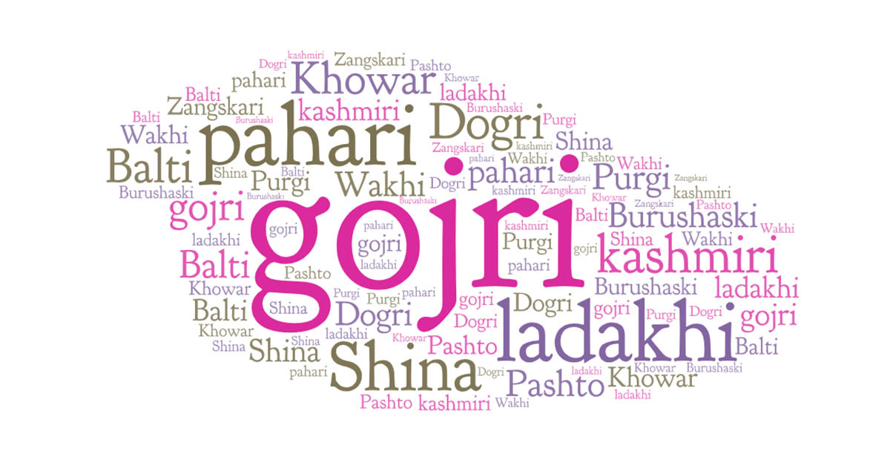
Official languages
Provisions of Part XVII of the Constitution apply to J&K only insofar as they relate to,
(i) the official language of the Union;
(ii) the official language for communication between one state and another; or between a state and the Union; and
(iii) language of the proceedings in the Supreme Court.
Urdu is the official language of the state but use of English is permitted for official purposes unless the state legislature provides otherwise.

Slide 15
Autonomy of Jammu and Kashmir
Any action of the Union Legislature or Union Executive which results in alteration of the name or territories or an international treaty or agreement affecting the disposition of any part of the territory of the state requires the consent of the State Legislature or the State Executive (as the case may be) to be effective.
The Union has no power to suspend the Constitution of J&K.
The subjects for legislation are divided into a 'Union List’ of ninety six subjects, a 'State List ‘of sixty six items, and a 'Concurrent List’ of forty seven items.
ninety-four of the ninety-seven items in the Union List applied to Jammu and Kashmir. Of the 'Concurrent List', twenty-six of the forty-seven items applied to Jammu and Kashmir

Slide 16
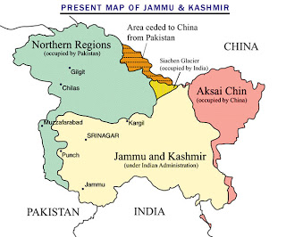
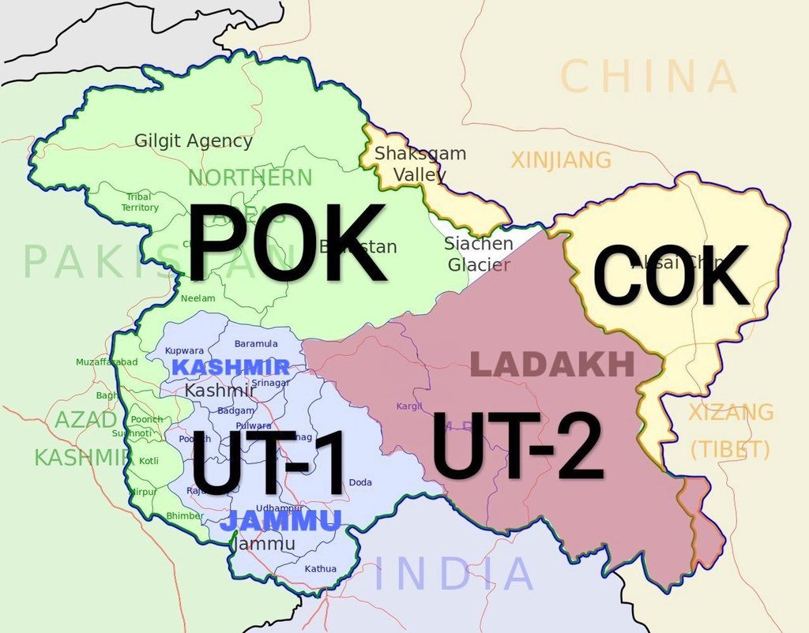
Relation Of Kashmir
Article 3 in part 2 of the Jammu and Kashmir constitution stated "Relationship of the State with the Union of India:-The State of Jammu and Kashmir is and shall be an integral part of the Union of India."
Article 5 of the part 2 was about extent of "Executive" and "Legislative" powers of the state and stated that "Jammu and Kashmir Legislative Assembly has executive and legislative power of all matters except those with respect to which Parliament of India has power to make laws for the State under the provisions of the Constitution of India". Sectors in which Government of India can make laws for Jammu and Kashmir includes Defence sector, Foreign affairs, Finance and Communication.
Article 147 of Part 12 was about amendment of the Jammu and Kashmir Constitution which stated that, "No Bill shall be introduced or moved in State Legislative Assembly to amend or change above mentioned articles 3 and 5
Article 48 of Part VI of Jammu and Kashmir constitution defines Pakistan administered Kashmir as "Pakistan Occupied Territory" (POK).
There were 111 seats in Jammu and Kashmir state legislative assembly. Of these seats, 24 were reserved for representatives from Pakistan-controlled Kashmir, to remain vacant until Pakistan ceases the "occupation" of Kashmir

Slide 17
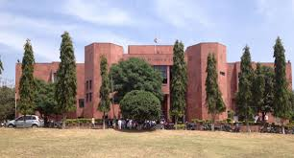
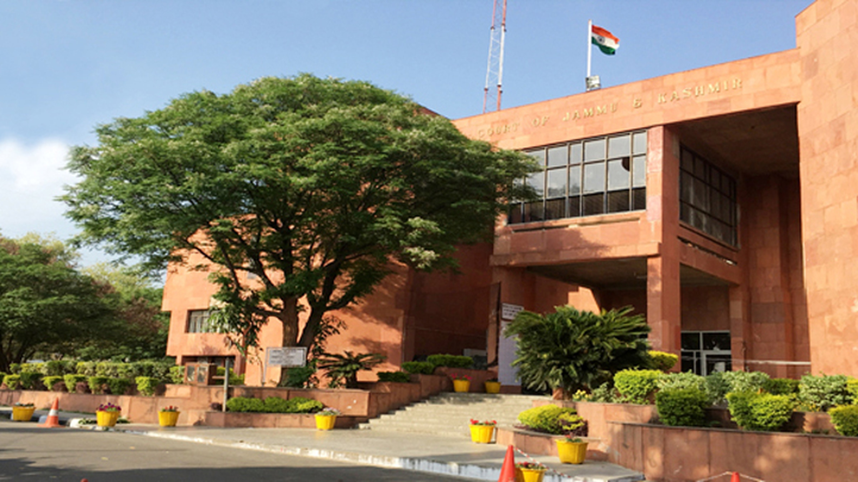
High Court Of J&K
The High Court of J&K has limited powers as compared to other High Courts within India. It can’t declare any law unconstitutional.
Unlike High Courts in other states, under Article 226 of the Constitution, it can’t issue writs except for enforcement of Fundamental Rights.

Slide 18
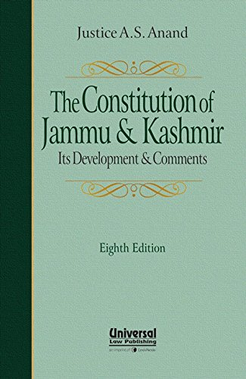
Amendment Of State Constitution
The Provisions of the State Constitution (except those relating to the relationship of the state with the Union) may be amended by an Act of the Legislative Assembly of the state passed by not less than two-thirds of its membership.
If such amendment seeks to affect Governor or Election Commission, it needs President’s assent to come into effect. No amendment of the Constitution of India shall extend to J&K unless so extended by an order of the President under Article 370(1).
No bill or amendment can be introduced or moved in either House of the Legislature which seeks to make any change in the provisions which is not applicable to the state or which do not extend to matters those with respect to which Parliament has power to make laws for the State under the provisions of the Constitution of India.

Slide 19
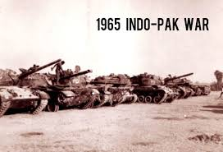
PAK-IND War of 1965 :
This war started following Pakistan’s Operation Gibraltar, which was designed to infiltrate forces into Jammu & Kashmir to precipitate an insurgency against rule by India. India retaliated by launching a full-scale military attack on West Pakistan. The seventeen-day war caused thousands of casualties on both sides and witnessed the largest engagement of armored vehicles and the largest tank battle since World War II . The hostilities between the two countries ended after a ceasefire was declared following diplomatic intervention by the Soviet Union and USA and the subsequent issuance of the Tashkent Declaration. India had the upper hand over Pakistan when the ceasefire was declared.

Slide 20
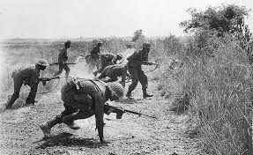
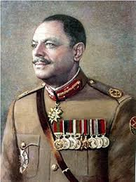
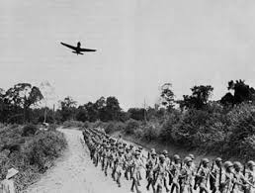
The second Indo-Pakistani conflict (1965) was also fought over Kashmir and started without a formal declaration of war. The war began in August 5, 1965 and was ended Sept 22, 1965.
After Pakistan was successful in the Rann of Kutch earlier in 1965, Ayub Khan the Pakistani army general and the second President of Pakistan was pressured by the hawks in his cabinet (led by Z.A. Bhutto) and the army to infiltrate the ceasefire line in Kashmir. Ayub Khan calculated that "Hindu morale would not stand more than a couple of hard blows at the right time and place” although by this time Operation Gibraltar had failed and India had captured the Haji Pir Pass.
The initial battles between India and Pakistan were contained within Kashmir involving both infantry and armor units with each country's air force playing major roles.

Slide 21
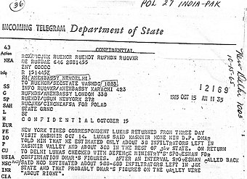
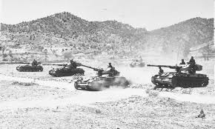
By Sept 22 both sides had agreed to a UN mandated cease-fire ending the war that had by that point reached a stalemate.
Overall, the war was militarily inconclusive; each side held prisoners and some territory belonging to the other. Losses were relatively heavy--on the Pakistani side, twenty aircraft, 200 tanks, and 3,800 troops.

Slide 22
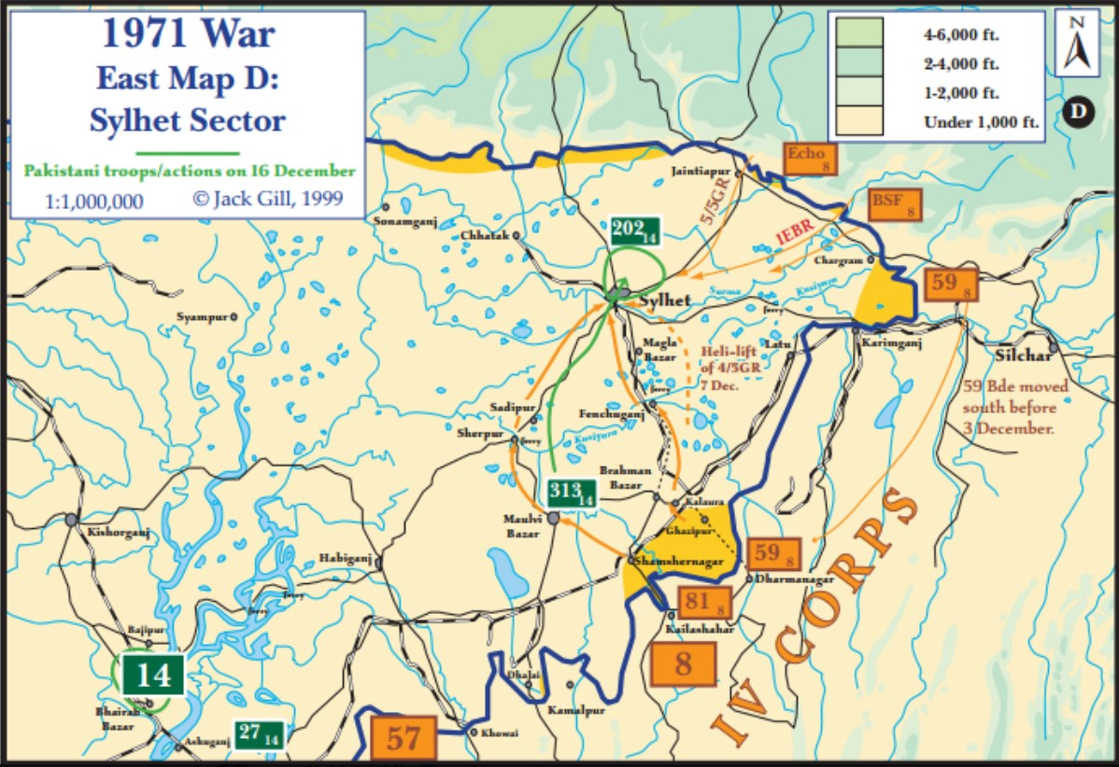
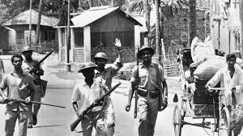
1971 war: The story of India's victory, Pak's surrender, Bangladesh freedom.
On 16th December 1971, India won the war against Pakistan that resulted in the birth of Bangladesh (then East Pakistan).
Pakistan lost half its country, its forces in the East, and had to publicly surrender to India. It was also the largest military surrender after World War II.

Slide 23
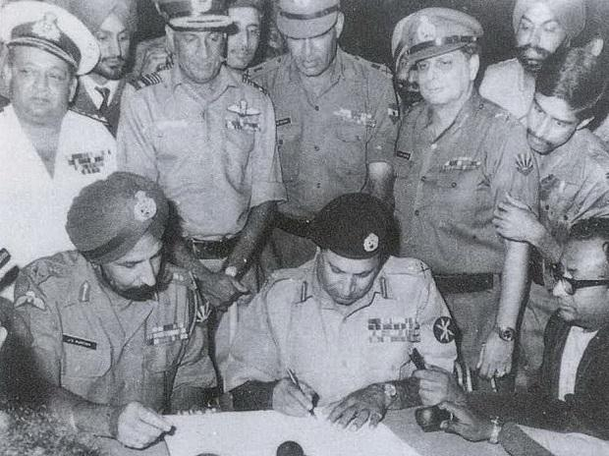
The war ended after the chief of the Pakistani forces, General Amir Abdullah Khan Niazi, along with 93,000 troops, surrendered to the joint forces of Indian Army and Bangladesh's Mukti Bahini.
General A A K Niazi signed the Instrument of Surrender on 16 December 1971 in Dhaka, marking the formation of East Pakistan as the new nation of Bangladesh. Pakistan also lost half of its territory with the birth of Bangladesh.

Slide 24
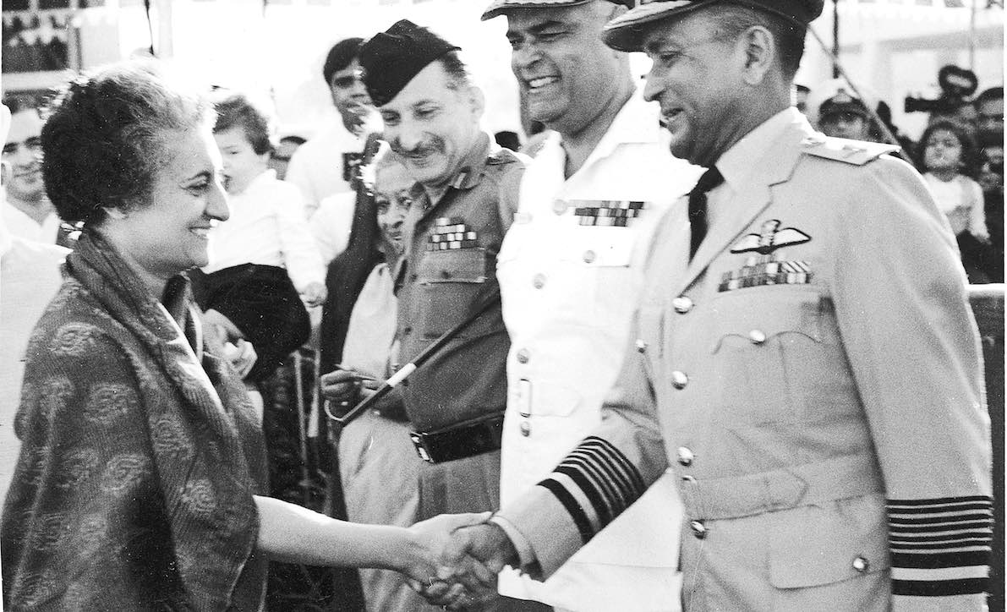
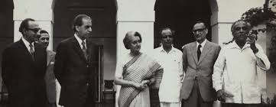
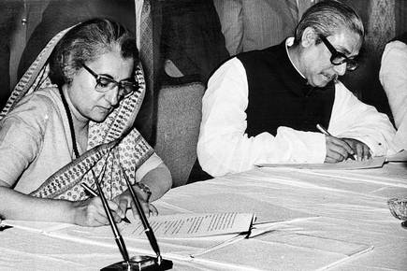
As Pakistan’s atrocities increased, former Prime Minister Indira Gandhi decided to take action against Pakistan at the same time give refuge to civilians from other side of the border.
She ordered Army Chief General Sam Manekshaw to launch offensive against Pakistan following which India launched a full-scale war against its neighbour.
On December 6, she announced in Parliament that India had accorded recognition to the Bangladesh Government.

Slide 25
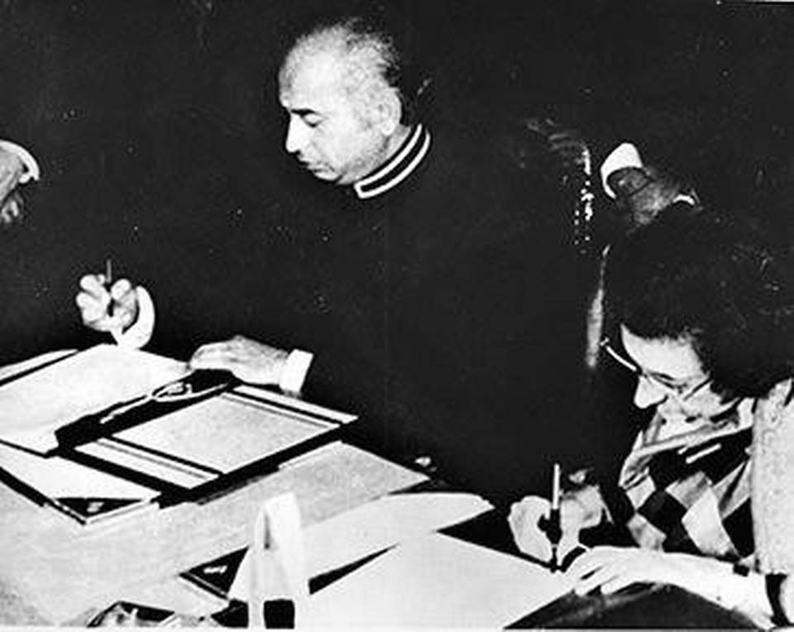
Simla Agreement 1972 :
The Simla Agreement signed by Prime Minister Indira Gandhi and President Zulfikar Ali Bhutto of Pakistan on 2nd July 1972 was much more than a peace treaty seeking to reverse the consequences of the 1971 war (i.e. to bring about withdrawals of troops and an exchange of POWs). It was a comprehensive blue print for good neighbourly relations between India and Pakistan. Under the Simla Agreement both countries undertook to renounce conflict and confrontation which had marred relations in the past, and to work towards the establishment of durable peace, friendship and cooperation.

Slide 26
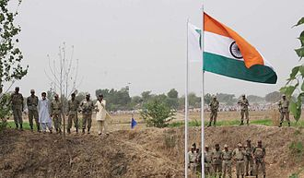
The Simla Agreement contains a set of guiding principles, mutually agreed to by India and Pakistan, which both sides would adhere to while managing relations with each other. These emphasize: respect for each other’s territorial integrity; non-interference in each other’s internal affairs; respect for each others unity, political independence; equality; and renouncing hostile propaganda. The following principles of the Agreement are:
A mutual commitment to the peaceful resolution of all issues through direct bilateral approaches.
To build the foundations of a cooperative relationship with special focus on people to people contacts.
To uphold divinity of the Line of Control in Jammu and Kashmir, which is a most important CBM between India and Pakistan, and a key to durable peace.

Slide 27
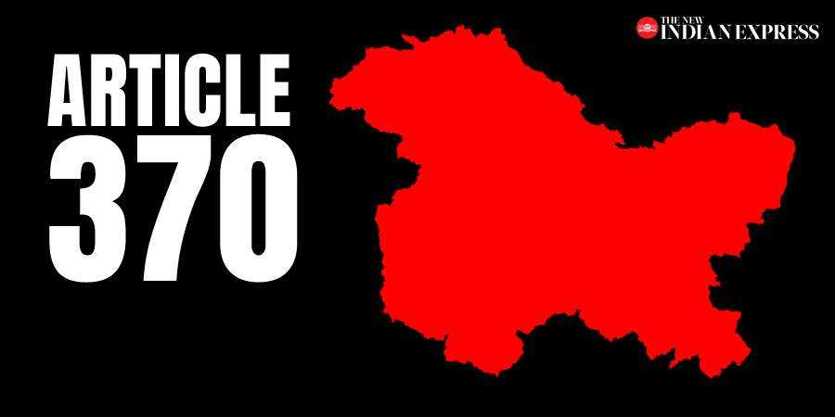
Article 370
Special status to Jammu and Kashmir.
The article was drafted in Part XXI of the Constitution titled "Temporary, Transitional and Special Provisions".
Since the Constituent Assembly dissolved itself without recommending the abrogation of Article 370, the article was deemed to have become a permanent feature of the Indian Constitution.

Slide 28
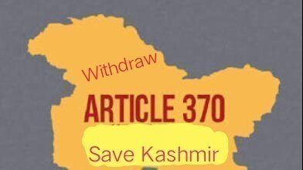
Why was Article 370 withdrawn?
In April 2018, the Supreme Court of India ruled that Article 370 had attained permanency since the state constituent assembly has ceased to exist.
To overcome this legal challenge, the Indian government instead rendered Article 370 as 'inoperative' even though it still exists in the constitution.

Slide 29
When was Article 370 withdrawn?
On 5 August 2019, the Government of India revoked the special status, or limited autonomy, granted under Article 370 of the Indian Constitution to Jammu and Kashmir—a region administered by India as a state which consists of the larger part of Kashmir which has been the subject of dispute among India, Pakistan, and China since 1947.

Slide 30
How was Article 370 withdrawn?
Article 370(3) - Which gives the president of India the power to amend or repeat article 370 itself through a public notification provided that “the recommendation of the Constituent Assembly of the State” is given before the president issues such a notification.

Slide 31
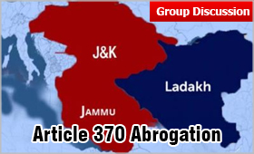
Legal Challenges to the withdrawal of Articles 370
On 28 August 2019, the Supreme Court of India agreed to hear multiple petitions challenging the abrogation of Article 370 and the subsequent bifurcation of Jammu and Kashmir into two union territories. It constituted a five-judge bench for the same.

Slide 32
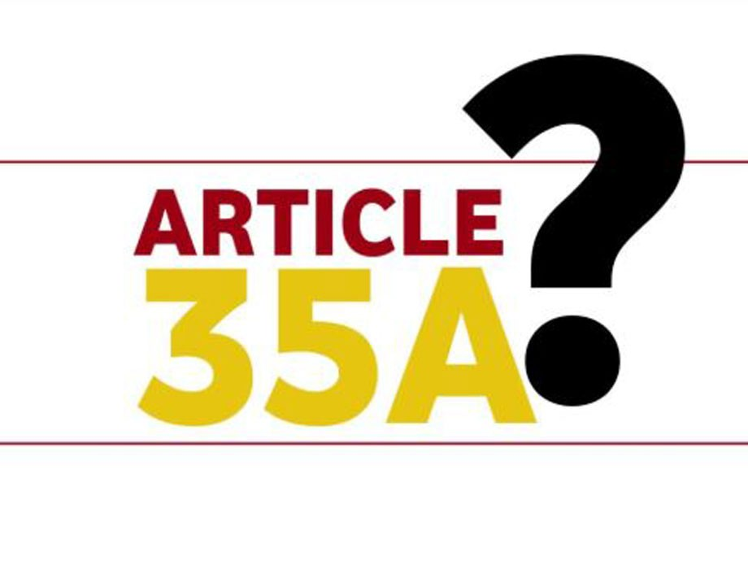
Legal Challenges to withdrawal of 35A
Article cannot be revoked as Article 35A was issued in exercise of the powers conferred by Article 370 (1) of the constitution, basis which the state enjoys its autonomy.
Article 370 and 35A are the constitutional connection between Jammu and Kashmir and the Central government and any tinkering with them will render the Treaty of Accession null and void.
It contradicts the ethnicity preserving laws .

Slide 33

Thank you
Presentation and discussion by:-
Amaan Mukadam
Suraj Pankaj
Siddharth Pandya
Kartik Padave

